Slide 1
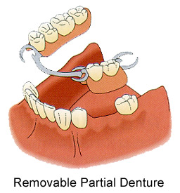
INTRODUCTION - REMOVABLE PARTIAL DENTURE
Dr. Niraj Mishra
Assistant Professor
Dept.Of Prosthodontics

Slide 2
Prosthesis-
“an artificial replacement of an absent
part of the human body.”
Appliance - device worn by the patient in the
course of treatment. (such as splints,
orthodontic appliances, and space maintainers)

Slide 3
Prosthetics-
“art and science deal prosthesis.”
Prosthodontics-
“the dental specialty pertaining to the
missing or deficient teeth and/or
maxillofacial tissues using biocompatible
substitutes.”

Slide 4
PROSTHODONTICS
FIXED
MAXILLOFACIAL
IMPLANT
REMOVABLE
COMPLETE
PARTIAL
FLIPPERS=TISSUE SUPPORTED
CAST PARTIAL

Slide 5
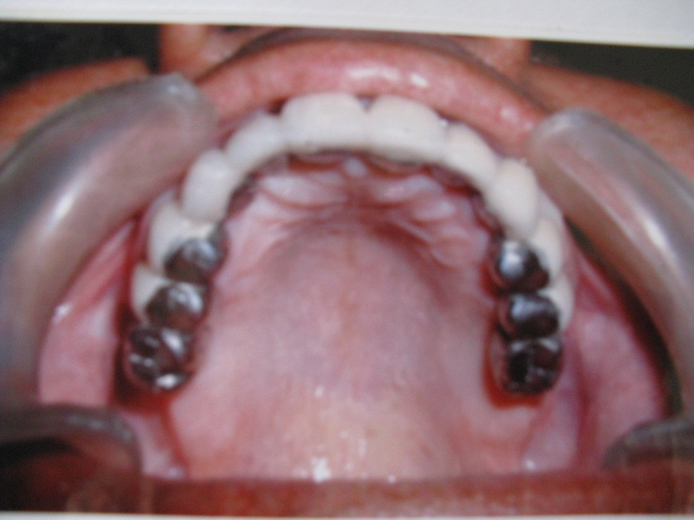
Fixed Partial Denture-
the replacement of teeth by artificial substitutes that not readily removed from the mouth.

Slide 6
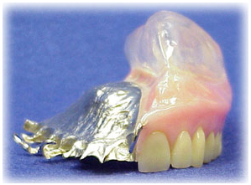
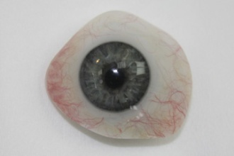
Maxillofacial Prosthetics-
Prosthesis of jaws and facial structures.
Eg.- Obturators, ear,
orbital etc.

Slide 7
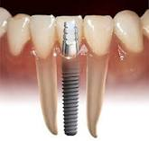
Dental Implants-
a prosthetic device made of alloplastic material(s) implanted into the oral tissues to provide retention and support for a fixed or removable dental prosthesis.

Slide 8
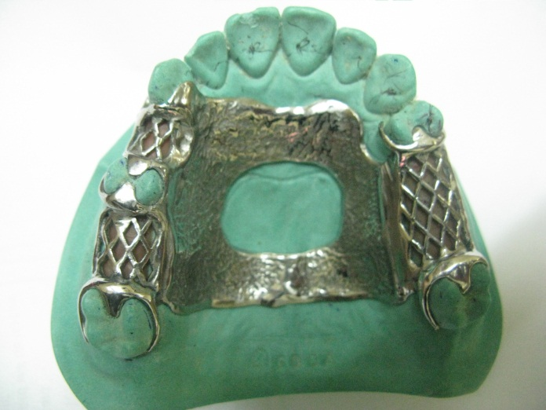
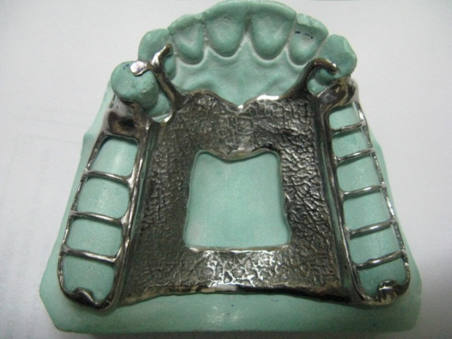
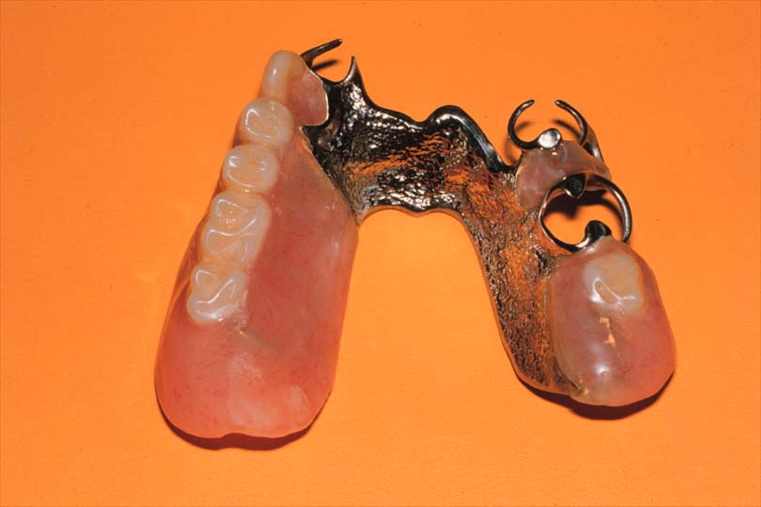
Removable Partial Denture –
a prosthesis that replaces some teeth in a partially dentate arch, and can be removed from the mouth and replaced at will.
Tooth supported
Tooth and tissue supported
( Distal Extension RPD)

Slide 9
CLASP RETAINED PARTIAL DENTURE
RPD retained by clasps
(= retainer).
Planned RPD
Unplanned / tissue supported RPD
clasps of orthodontic wires
orthodontic forces
movement of tooth

Slide 10
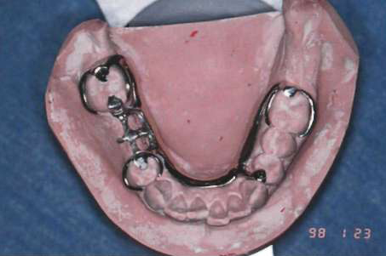
Planned RPD = Cast Partial Denture = Clasp retained RPD
Advantage
RETENTION
Disadvantages
Less economical
Time consuming
Prone to caries
Unaesthetic

Slide 11
INDICATIONS FOR RPD
Length of edentulous span that contraindicates use of FPD
No abutment tooth posterior to edentulous space
Reduced periodontal support of remaining teeth
Need for cross-arch stabilization
Excessive bone loss of residual ridge

Slide 12
6. Physical or emotional problem of the patient
7. Esthetics of primary concern in replacement of multiple
missing anterior teeth
8. Need to replace teeth immediately after their extraction
9. Patient desire
10. Economical status

Slide 13
SIX PHASES OF PARTIALDENTURE SERVICES
1. Education of patient
“effective communication between the dentist and the patient concerning dentistry and principles of treatment and prevention. The procedure of increasing the knowledge of the oral cavity and its care to the point where the reasons for the proposed services are understood.”

Slide 14
Pt. education should begin at the initial contact with the patient and continue throughout the treatment
Responsibilities for the ultimate success of the RPD is shared by the dentist and the patient.
Pt. will have an understanding of benefits of RPD, required oral care and maintenance procedure to ensure the success of the partial denture

Slide 15
2. TREATMENT PLANNING AND DESIGN
Based on health history and complete oral examination
Clinical
Radiographic
Caries
Condition of existing restoration
Periodontal condition
Abutment teeth and remaining teeth
Evaluation of occlusal relations of remaining teeth
Visually
By articulating diagnostic cast

Slide 16
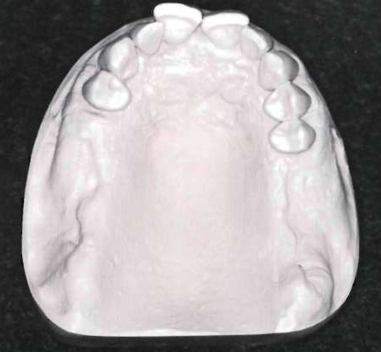
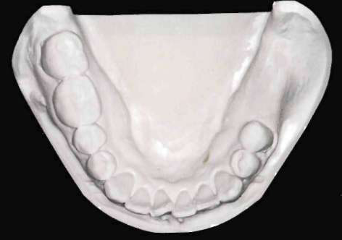
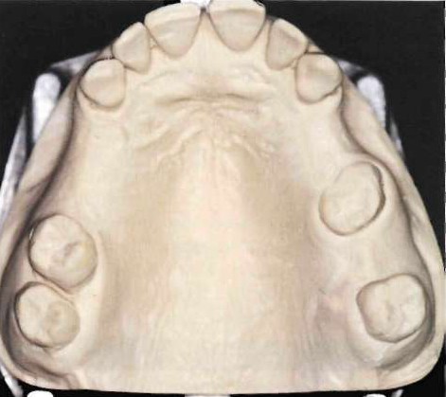
Finally Treatment Planning based on support available
for PD.
Design
Tooth supported
Tooth-tissue supported \ Distal extension PD
-the extension bases derive their principal support
from the underline residual ridge.

Slide 17
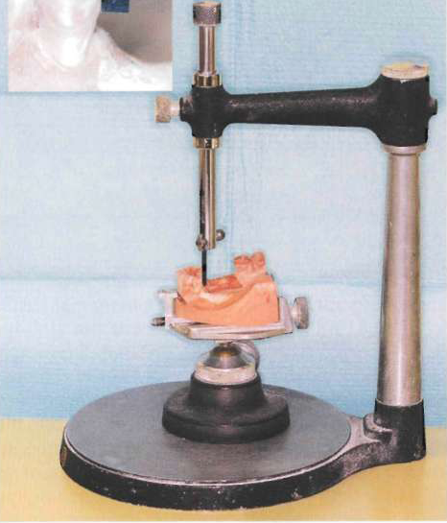
SURVEYING
Surveyor; an instrument used to determine the relative paralelism of two or more surfaces of the teeth or other parts of the cast of a dental arch.
The primary purpose of surveying is to plan those modifications of oral structures necessary to fabricate a RPD.

Slide 18
Mouth Preparations
Occlusal adjustments
Abutment restoration
Abutment modification
Proximal tooth preparation; should be parallel to provide guiding planes during placement and removal of the prosthesis.

Slide 19
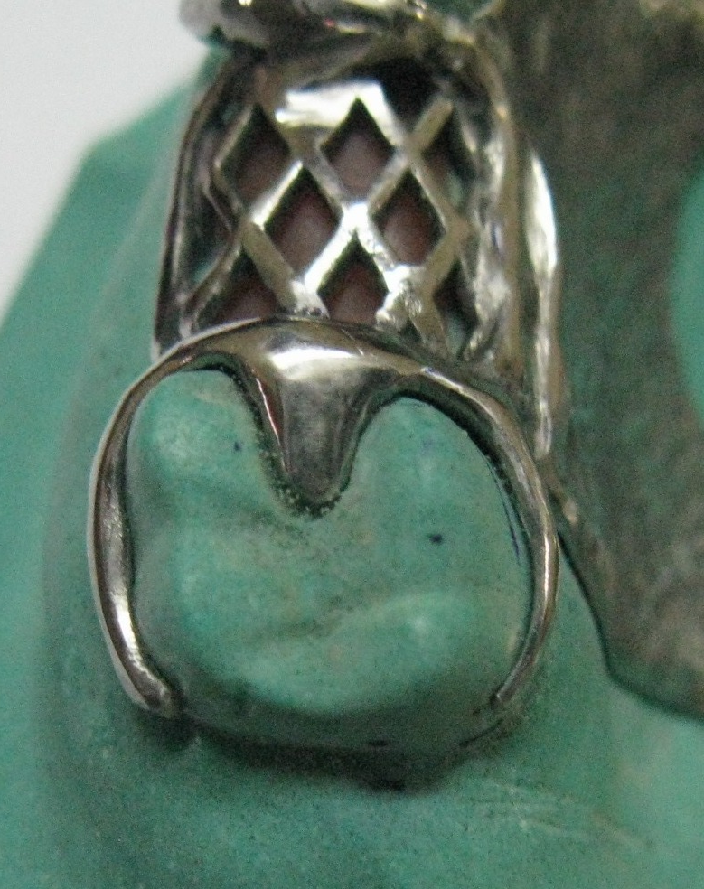
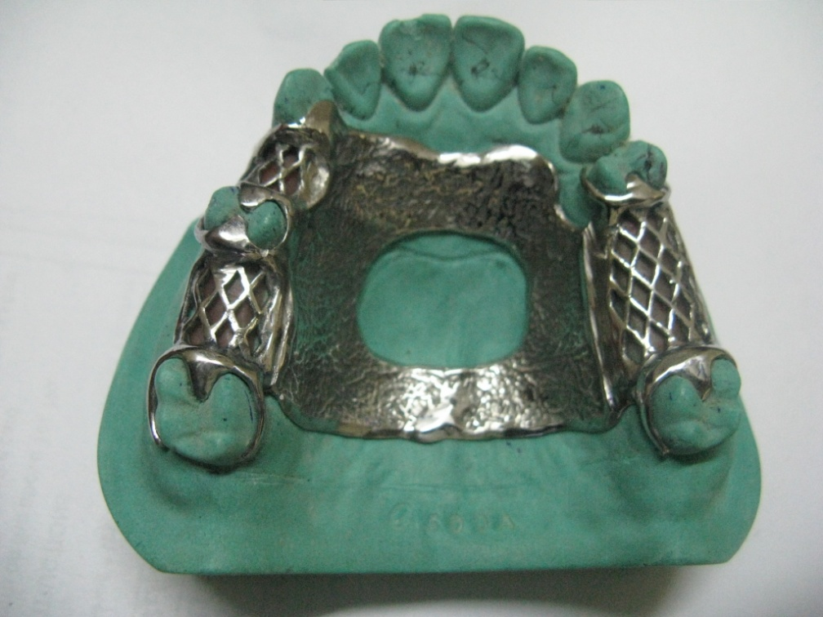
Occlusal rest seat; will direct occlusal forces along the long axis of the supporting teeth.
Retentive areas; should be sufficient to resist reasonable dislodging forces.

Slide 20
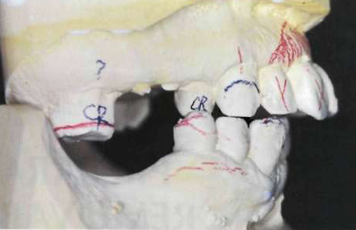
Final Impression
Master Cast
Final Design of denture Framework outlined with coloured pencil
Tripoding the Cast

Slide 21
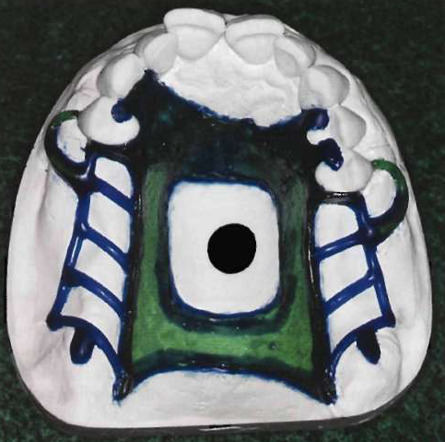
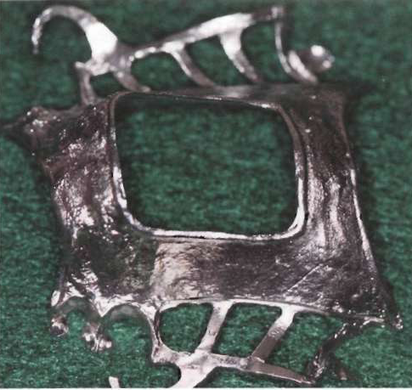
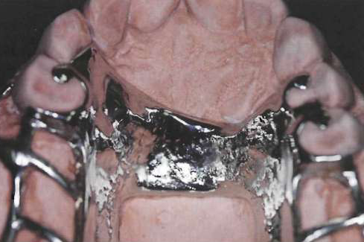
LAB WORK
Wax up
Metal framework fabrication
Evaluated for its fit in
the mouth
Make necessary adjustment

Slide 22
3. Support for the distal extension base
Tooth borne RPD; support comes entirely from the abutment teeth through the use of rest.
Distal extension PD;
Rotational movements under function
Loss of planned occlusal contacts
Undesirable forces to the abutment teeth
Best possible support should be provided to minimize these forces; it requires special impression technique to record the anatomic form of the teeth and supporting form of the lower edentulous ridge.

Slide 23
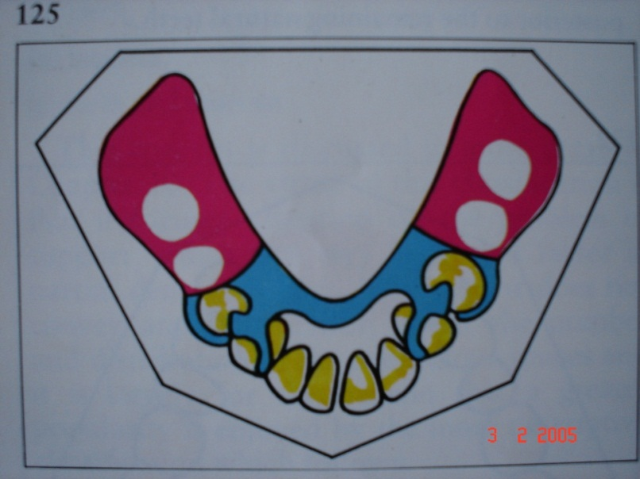
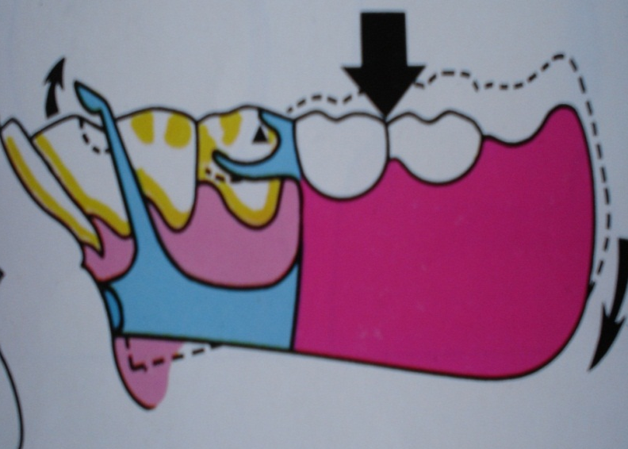
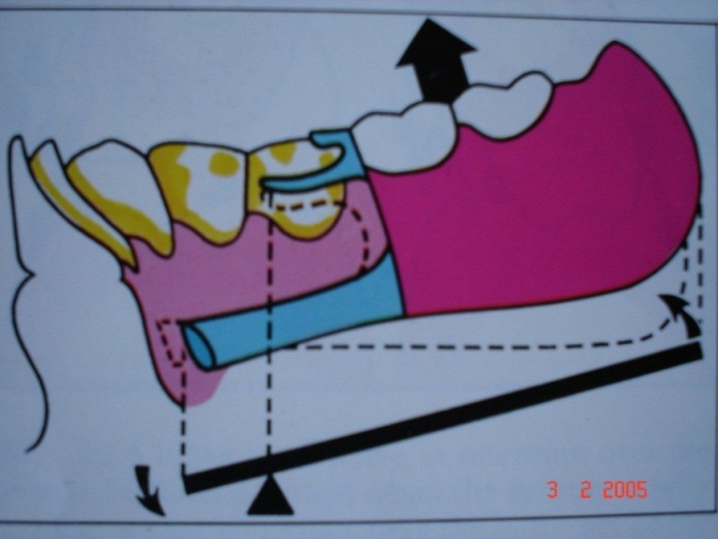

Slide 24
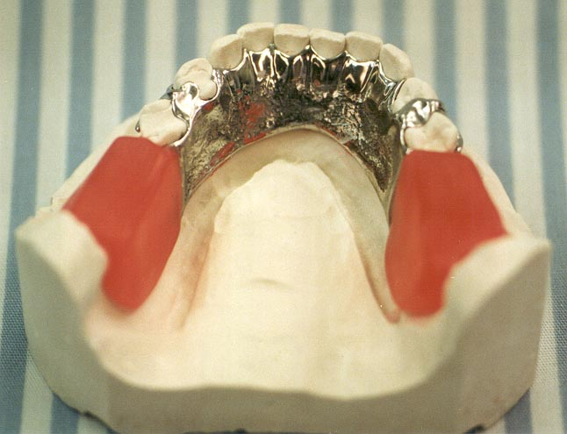
4. Establishment of occlusal relations
Jaw Relations with metal framework
Occlusal records made by various methods.

Slide 25
5. Initial placement Procedure
Denture base must reasonably perfected to the basal seat.
Occlusal harmony
Instructions for the denture care and oral structure

Slide 26
6. Periodic Recall
6 months recall period
To evaluate oral tissues and their response to the restorations.

Slide 27
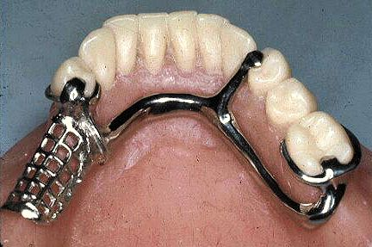
Components Of RPD
Major connector
Minor connector
Rests
Direct retainers
Indirect retainers
Denture bases
Replaced tooth/teeth

